Slide 1

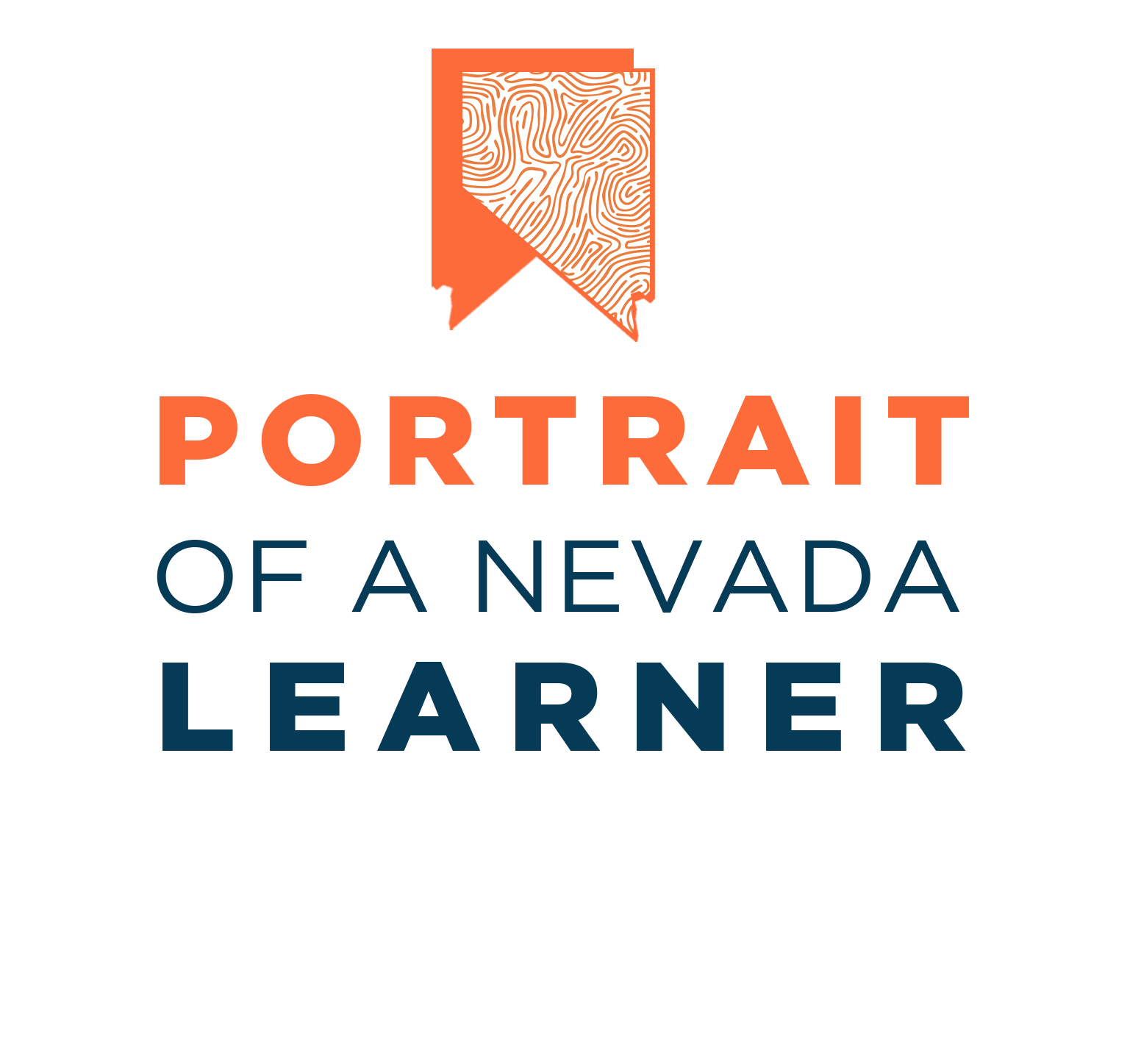


A Nevada Department of Education initiative in partnership with ed.Xtraordinary

Slide 2
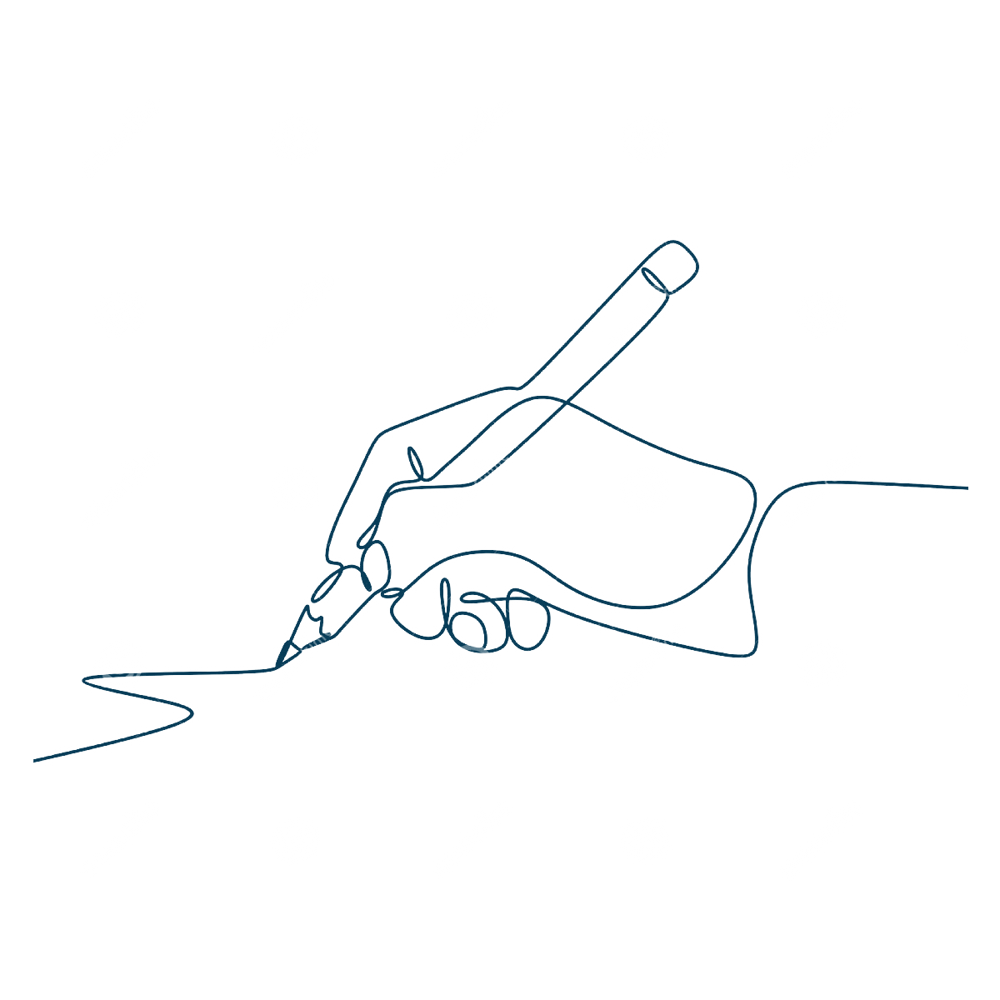

What is a Portrait of a Learner?
A community-wide vision statement of the attributes a learner must possess to succeed in learning and life, both in school and beyond, now and into a rapidly evolving future.
Notes:
10:16-10:22
Jeanine presents slides 5-12

Slide 3
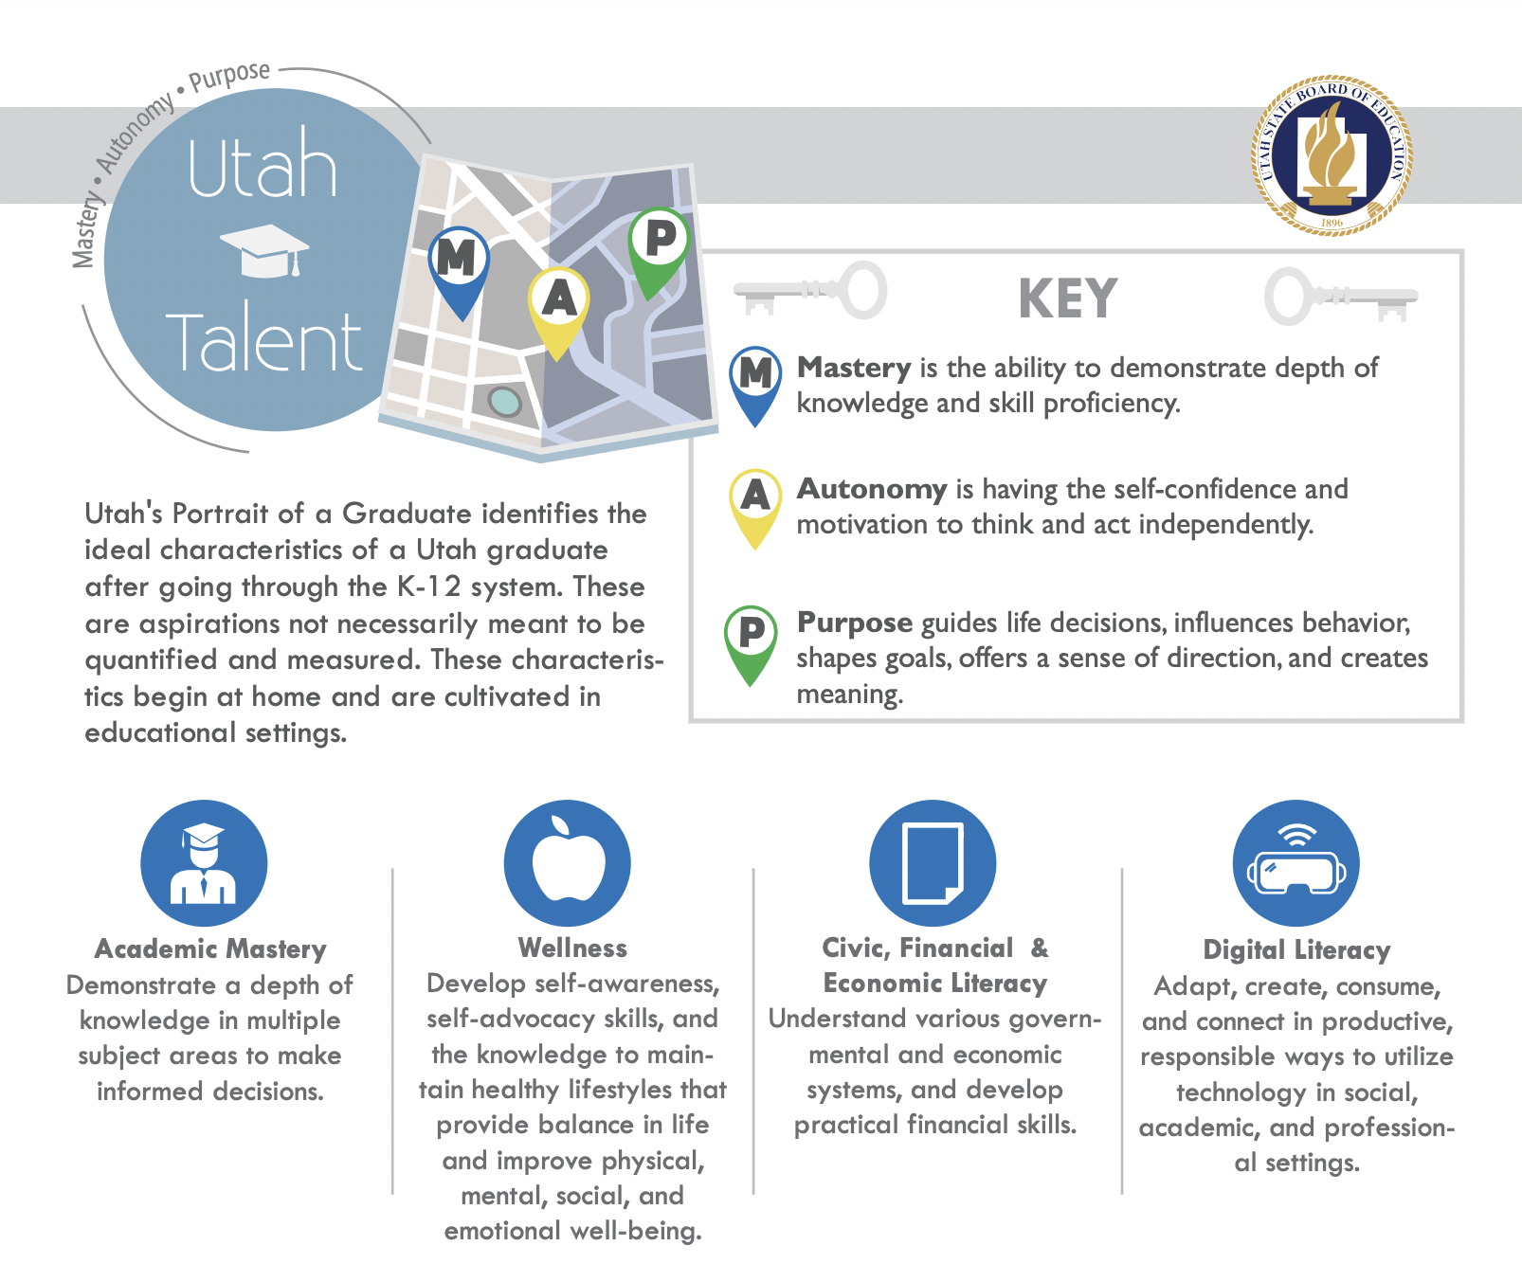
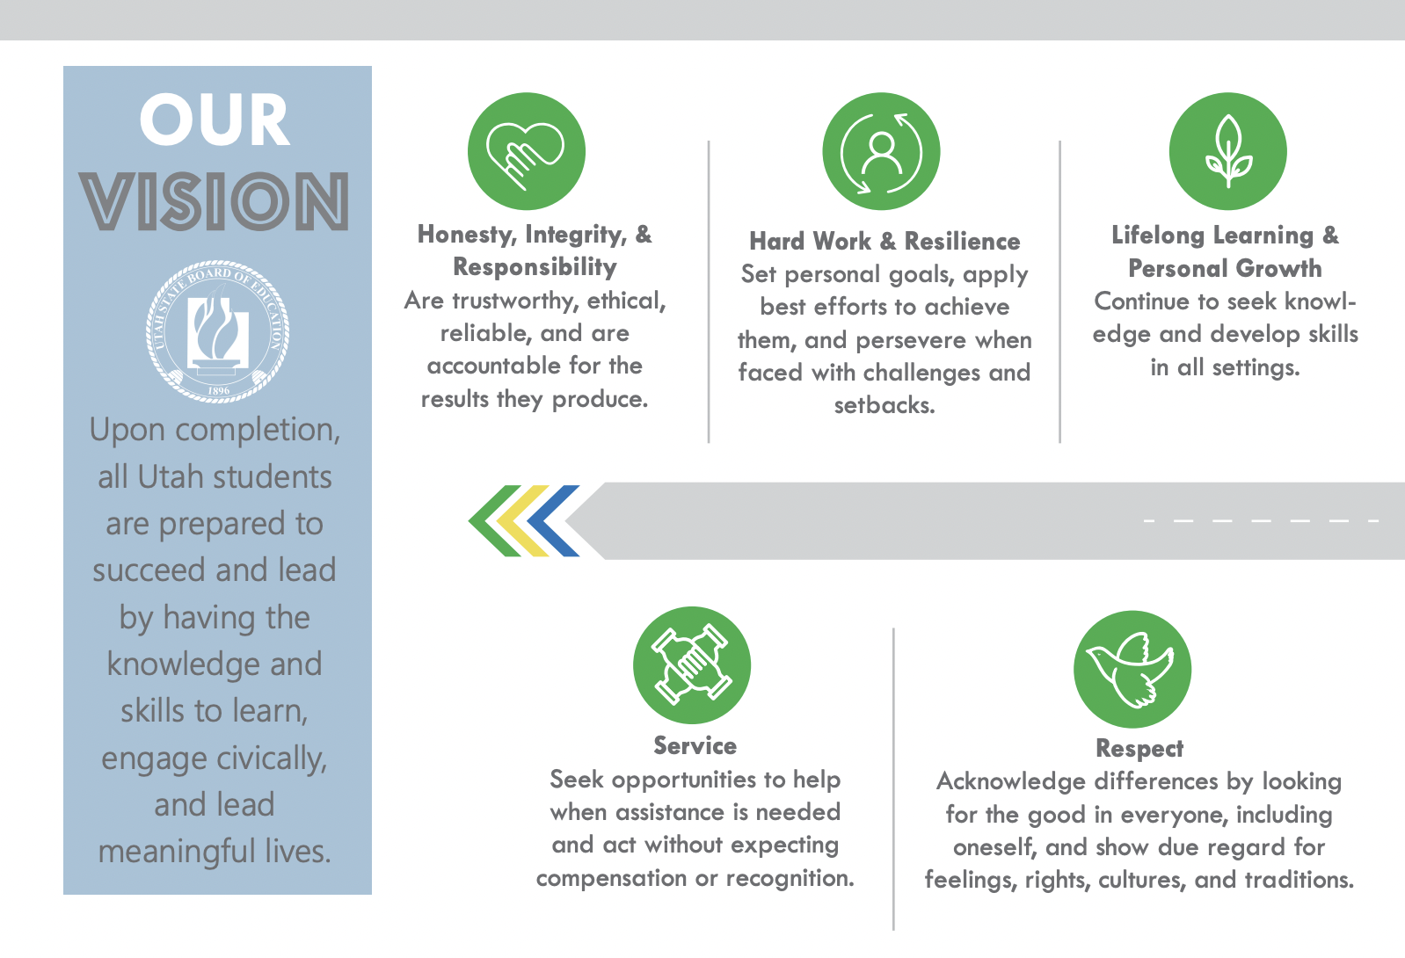
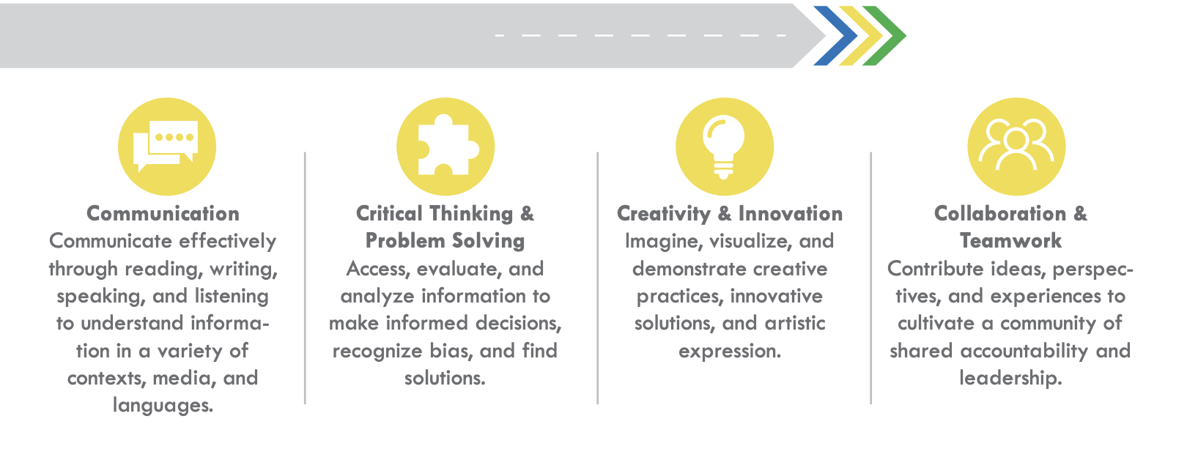
What are other states doing?

Slide 4
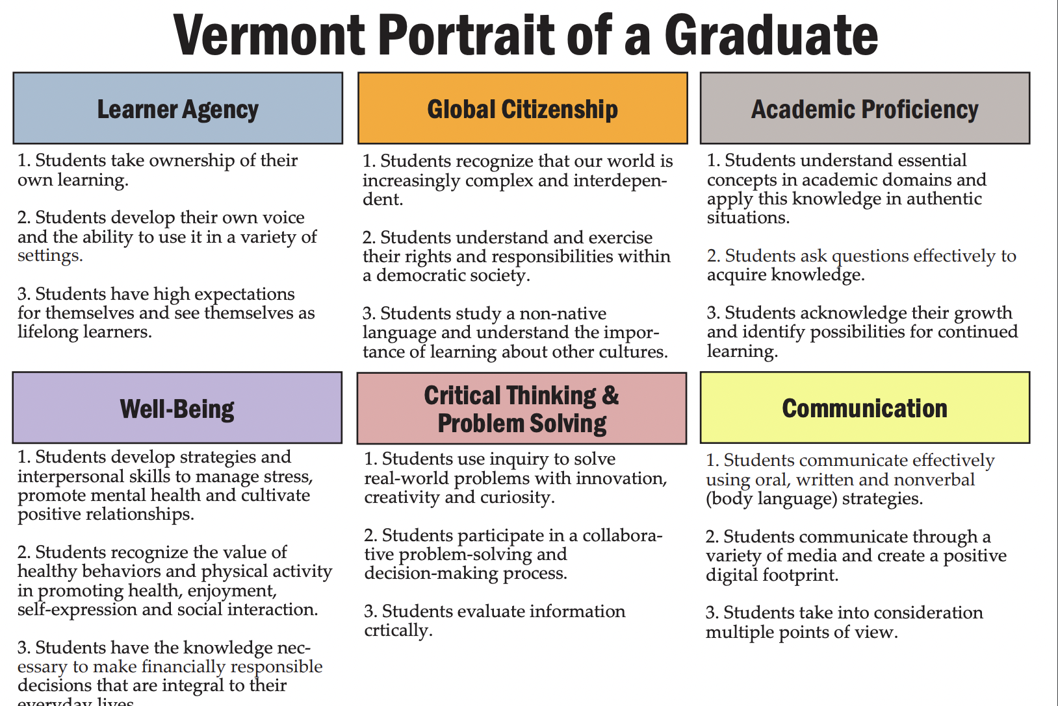
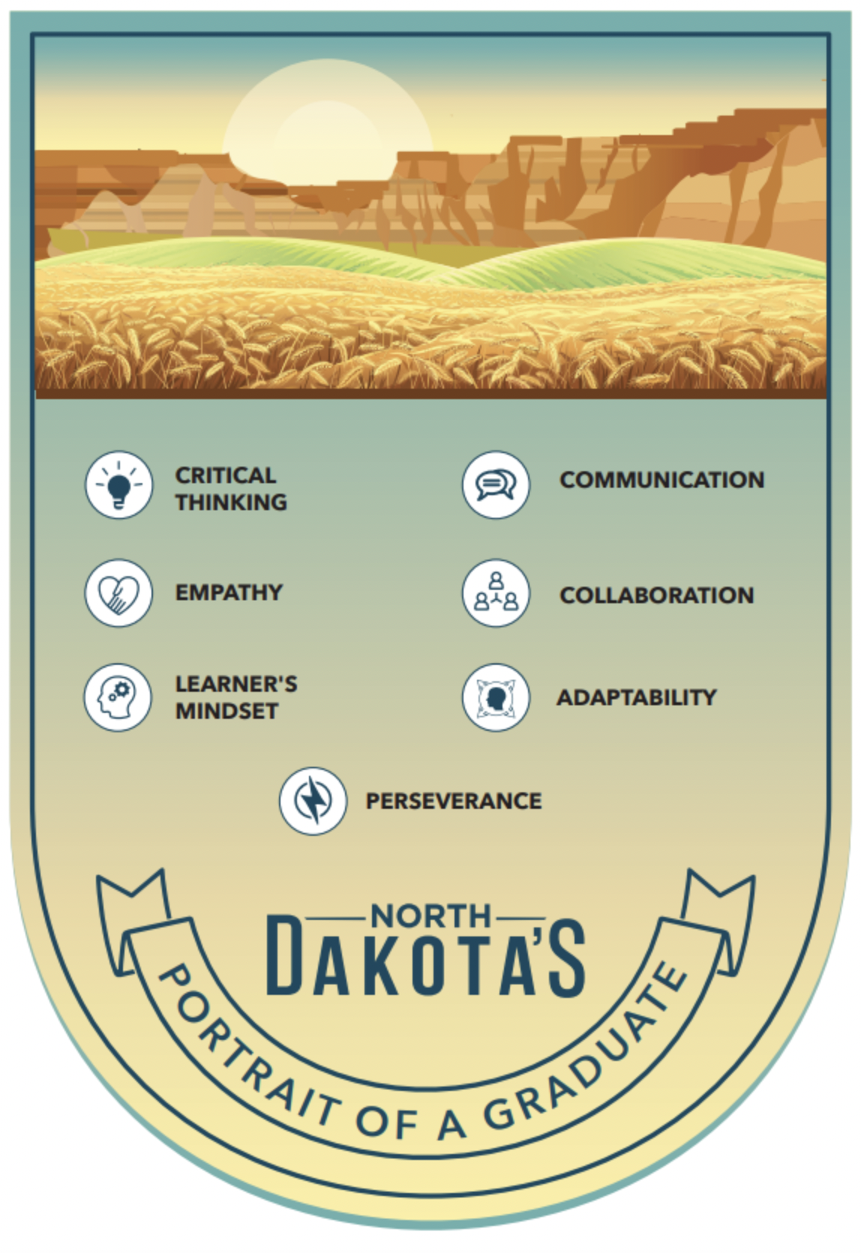
What are other states doing?

Slide 5

Portrait:
Who Young People Will Be
Competencies:
What Young People Can Do
Knowledge:
What Young People Will Know

Slide 6
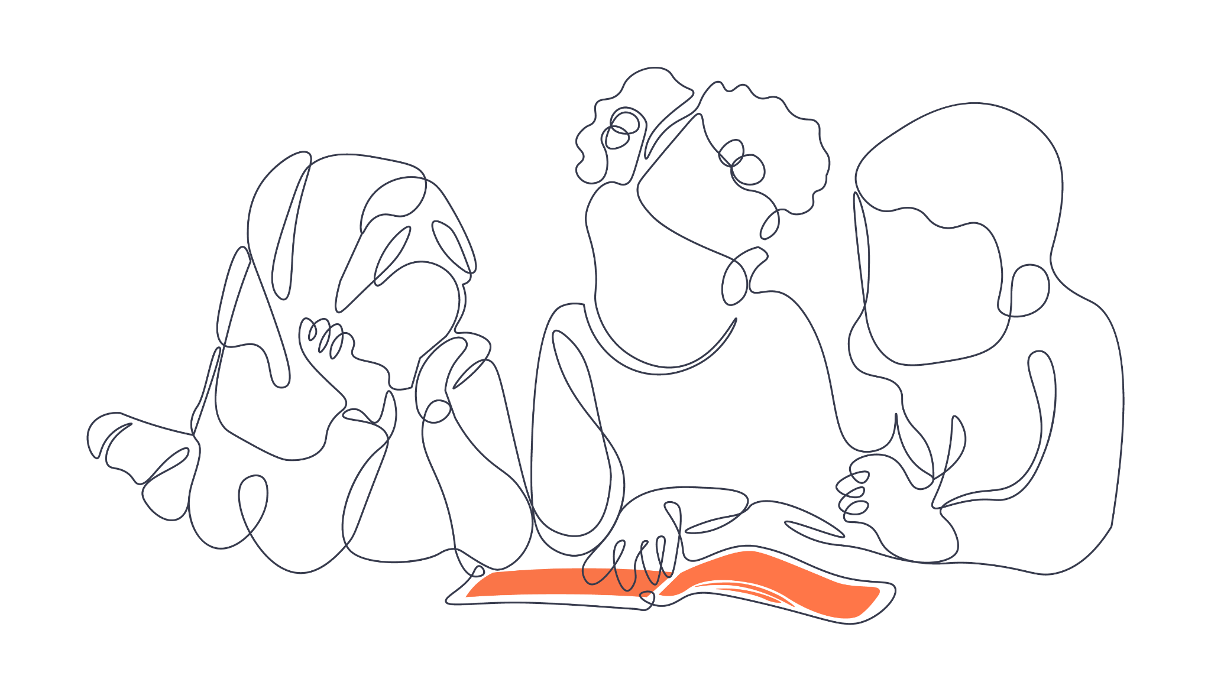
Connect.
Who do we want young people to be and why?
Notes:
10:09-10:16
Jeanine
3 minute table talk and stickie notes, 2 minutes to connect + reflect whole group
Erica 2 minute debrief

Slide 7
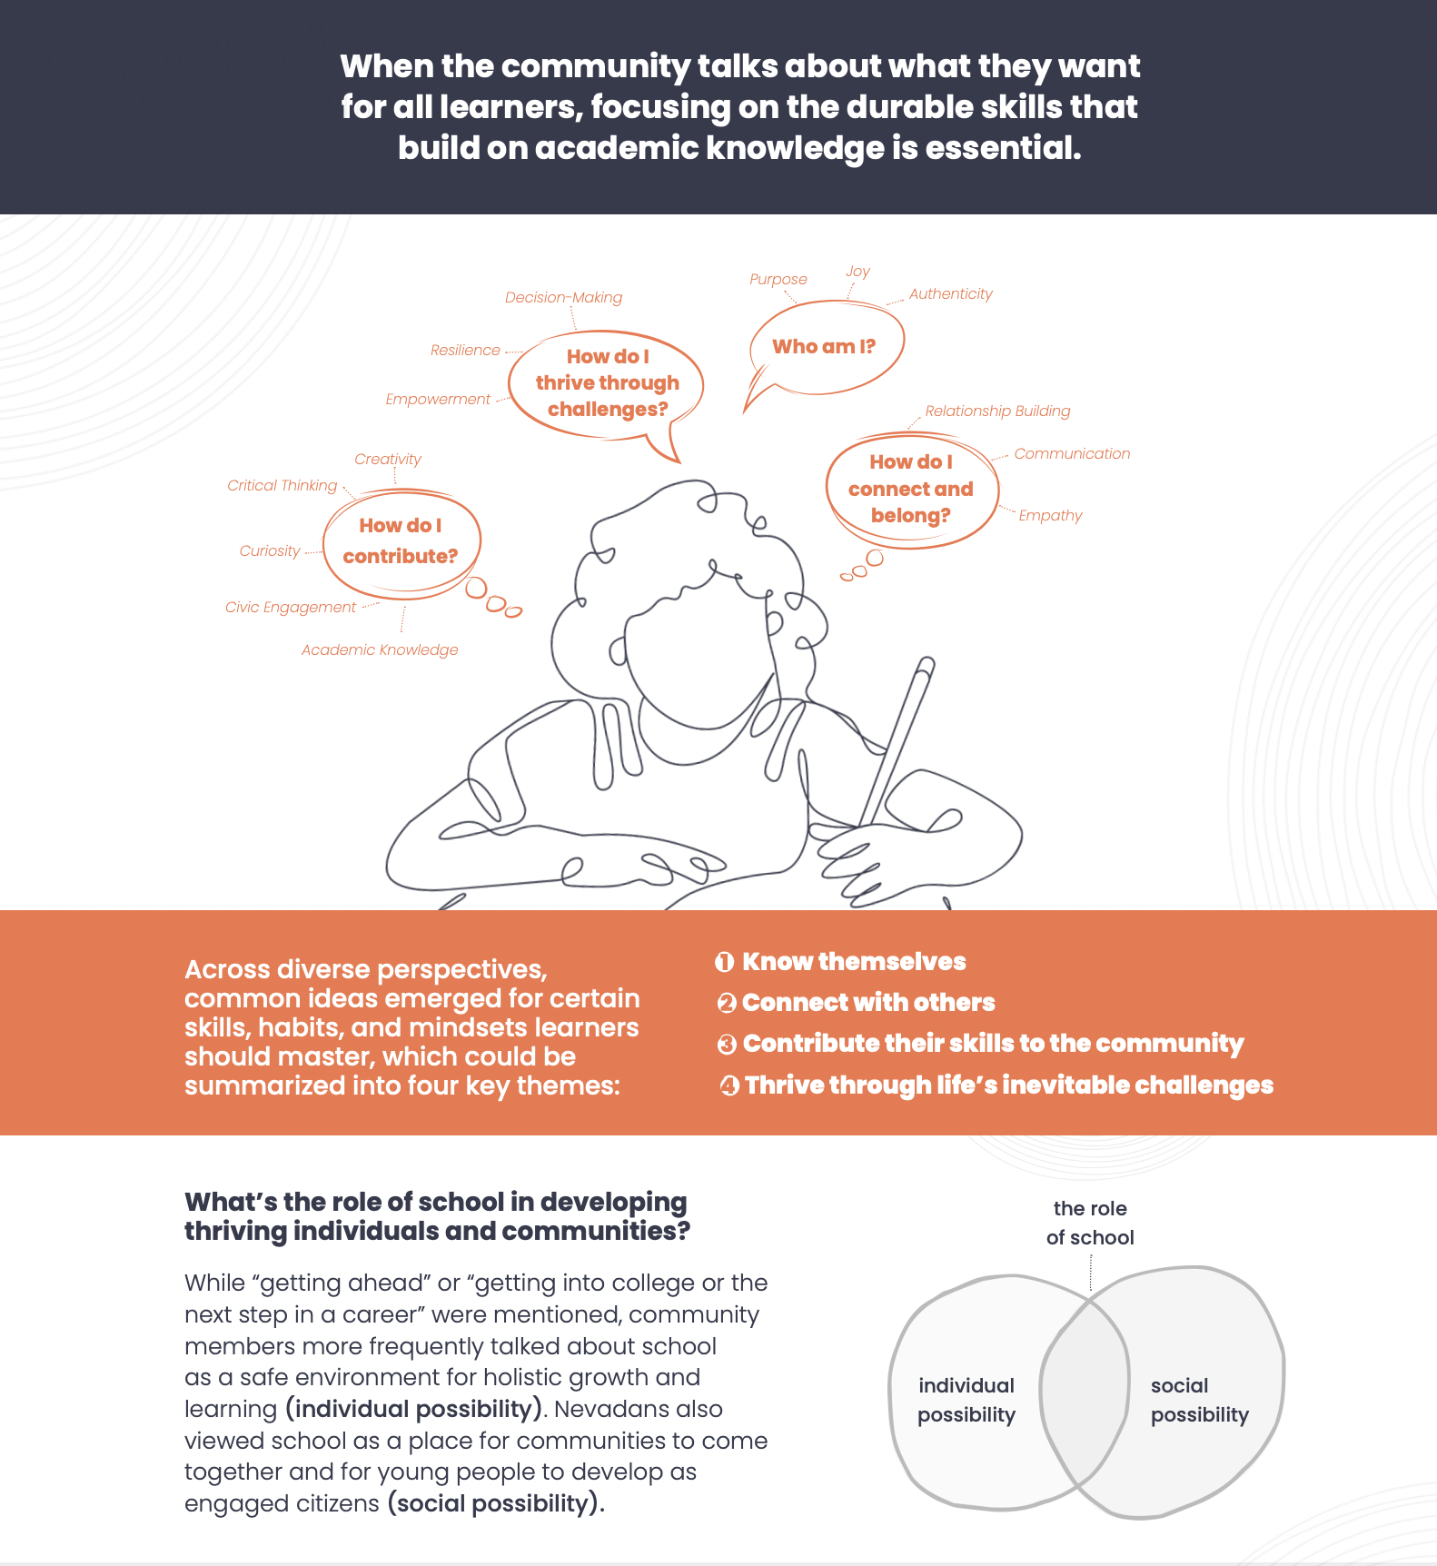

Slide 8
Next Steps
Follow these next steps at www.portrait.nvfutureoflearning.org
Take + share the Portrait Feedback survey!
Sign up for newsletter updates
Follow The Portrait of a Nevada Learner on Social Media

